Slide 1
English Language learner (ELL) Support program
ELL Student Support Program for CTE
Amanda Johnston

Slide 2
Program Name
Professional English Language Learner (PE2L)
Career and Technical Education Focus
Learn English in context of profession
Services geared to program content
Pilot at San Diego Mesa College Allied Health CTE Programs

Slide 3
Student Population Served
ELL students enrolled in CTE programs or certificates in Allied Health Professions.
Have not achieved transfer level English proficiency.
Education focused on
Effective verbal and written communication within the field of study
Pronunciation with an emphasis on professional terminology
Professional verbal and written communication necessary in industry
Equity and Awareness of cultures present in education and workplace

Slide 4
Identified Need- State and Institution
1) Equity Data at San Diego Mesa College
Percentage of students starting in ELL course attaining transfer level English knowledge has declined since 2006 (San Diego Mesa College, 2015).
2) 1,373,724 English language learners (22.1%) of the total enrollment in California
83.5% Spanish speakers
(California Department of Education, 2016a)
Notes:
To meet equity outcome of college. Overall English proficiency is 26%. By improving education of ELL students, we can also improve the diversity in health care fields of San Diego. This would allow for more effective patient care as providers would be able to communicate in English and other languages.
Large percentage of students in California public school system who are ELL students represents a large population of students who will need assistance in higher education.

Slide 5
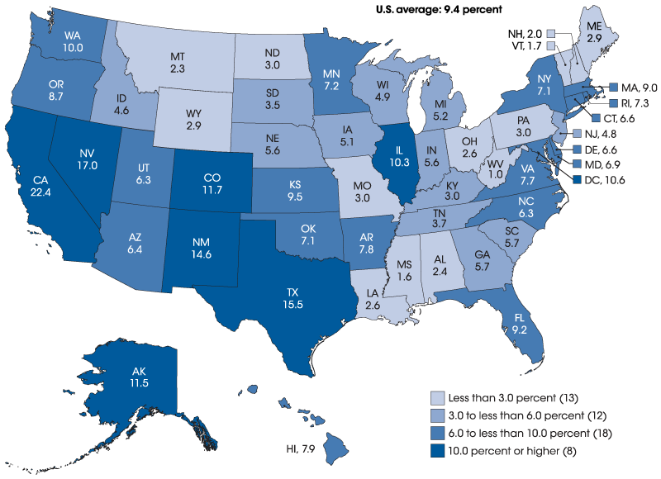
Identified Need- National
3) In the U.S.= 9.4% or 4.6 million ELL students
English Language Learners- Public K-12 (2014-15)
(U.S. Department of Education, 2017)
Notes:
Percentages demonstrate a current and future need as K-12 ELL students will complete high school and enter higher education viewing nation wide demand.

Slide 6
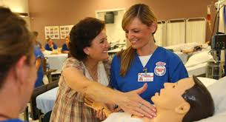
Identified Need- National
4) The percentage of children under age 18 living in poverty in 2013
Black children – 39%
Hispanic children- 30%
White and Asian children- 10% for each
Largest increases in undergraduate enrollment was with Hispanic and Black students.
(Musu-Gillette, 2016)
CTE Programs result in a jobs with a livable income.
Notes:
Offer opportunity of education, provide service to foster success. Success can include improved income status (rise from poverty).

Slide 7
Issues and Trends Influencing PE2L
Online education
Allows for students to maintain work schedule/income
Ability to learn at their own pace, as frequently as needed
Incorporate online terminology related to discipline
Scenario based videos with voice recording capability
Online documentation to mimic work requirements
Notes:
Students can master pronunciation, grammar, and technical terms with repetition allowed by online options.

Slide 8
Description
PE2L will provide students in Allied Health Programs support in progressing English language skills required in the health care industry, emphasizing the development of effective verbal and written communication specific to industry or discipline.
PE2L will increase awareness of cultural diversity and equity in education and workplace while developing effective communication strategies.

Slide 9
Similar programs
ESL Program of Study at Mesa Community College in Arizona includes courses focusing on grammar, listening, pronunciation, and writing.
(Mesa Community College, 2017)
English Health Train Program in San Francisco trained professionals to bridge the gap in underserved communities.
(City College of San Francisco and San Francisco State University, 2006)
Incorporating such topics with discipline specific content will ease development of learning outcomes and provides evidence of improved English proficiency (55% verbal & 98% written assessment improvement).
Notes:
English Health Train Program used a module workshop approach to meet their goals. Found 55% verbal improvement and 98% written improvement. Also saw 11% took and passed licensure exams, 22% enrolled in health care education program and 28% became employed in health care community

Slide 10
Program Outcomes
Students will be able to comprehend verbal communication related to their field of study.
Students will be able to comprehend written communication related to their field of study.
Students will be able to enunciate discipline specific terminology within proper English grammar.
Students will be able to create written documentation using proper English grammar within their course content and work setting.
Students will be able to evaluate relevant peer-reviewed articles including a written description of such evaluation.
Students will be able to relate cultural awareness to educational and professional setting.

Slide 11
Learning Outcomes
Describe challenges associated with improper communication in Allied Health professions.
Discuss tactics which foster effective verbal and written communication.
Demonstrate proper enunciation, grammar, and body language for Allied Health professions.
Demonstrate effective and efficient written communication in line with current industry standards.

Slide 12
Assessment Methods
Communication Rubric
Verbal (Speech Assignments)
Written (Written Assignments)
Surveys
Students
Faculty
Clinical Instructors
Advisory Committee
Employers
Pass Rate
Program Specific
Licensure Examinations
Employment Rate
Notes:
Rubric grading will be provided on all verbal and written assignment and will include firm evaluation descriptors to improve outcomes as necessary.

Slide 13
Budget and Funding
Strong Workforce Funding
Regional collaboration
Strengthen work force with high- demand, high-wage jobs (California Community College, 2017)
Perkins
California
Improve CTE Programs through instruction, services, and equity (California Department of Education, 2016b).

Slide 14
Thank you

Slide 15
Reference list
California Community Colleges. (2017). Strong Workforce Incentive Funding. Retrieved from http://doingwhatmatters.cccco.edu/StrongWorkforce/SWPIncentiveFunding.aspx
California Department of Education. (2016a). Facts About English Language Learners in California. Retrieved from http://www.cde.ca.gov/ds/sd/cb/cefelfacts.asp
California Department of Education. (2016b). Perkins. Retrieved from http://www.cde.ca.gov/ci/ct/pk/
City College of San Francisco and San Francisco State University. (2006). English Health Train, Bridges to Opportunity- Workforce Development for English Language Learners. [PowerPoint]. Retrieved from http://slideplayer.com/slide/3935205/

Slide 16
Core Data (CCD), English Language Learners in Public Schools [Map and Data File]. Retrieved from https://nces.ed.gov/programs/coe/indicator_cgf.asp
Mesa Community College. (2017). ESL Program of Study. Retrieved from https://www.mesacc.edu/departments/english/english-language-program/esl-program-study
Musu-Gillette, L., Robinson, J., McFarland, J., KewalRamani, A., Zhang, A., & Wilkinson-Flicker, S. (2016). Status and Trends in the Education of Racial and Ethnic Groups 2016 (NCES 2016-007). U.S. Department of Education, National Center for Education Statistics. Washington, DC. Retrieved from https://nces.ed.gov/pubs2016/2016007.pdf
San Diego Mesa College. (2015). Equity Data – Basic Skills ESL. [Graph illustration] Retrieved from http://www.sdmesa.edu/about-mesa/institutional-effectiveness/institutional-research/data-warehouse/esl.shtml

